Slide 1
Systolic Blood Pressure Measurement form Heart Rate Using IoT
Presented by:
Ifrat Jahan (2014-2-60-051)
Md. Lizur Rahman (2014-3-60-014)

Slide 2
Background
Our proposed model of systolic blood pressure measurement system contains two parameter.
Heart rate
Systolic blood pressure
The unit of Heart rate is BPM (Bits Per Minute)
The unit of Systolic blood pressure is mmHg (millimeters of mercury)

Slide 3
Background
Heart Rate
Heart rate is the speed of the heartbeat measured by the number of contractions of the heart per minute (bpm).
The heart rate can vary according to the body's Physical needs, including the need to absorb oxygen and emit carbon dioxide.
It is usually equal or close to the pulse measured at any peripheral point.
The American Heart Association states the normal resting adult human heart rate is 60–100 bpm [1].
[1] "All About Heart Rate (Pulse)". All About Heart Rate (Pulse). American Heart Association. 22 Aug 2017. Retrieved 25 Jan 2018.

Slide 4
Background
Systolic Blood Pressure
When your heart beats, it contracts and pushes blood through the arteries to the rest of your body. This force creates pressure on the arteries. This is called systolic blood pressure.
A normal systolic blood pressure is 120 or below.
A systolic blood pressure of 120-139 means you have normal blood pressure that is higher than ideal, or borderline high blood pressure. Even people with this level are at a greater risk of developing Heart disease [2].
[2] Goldblatt, H., Lynch, J., Hanzal, R.F. and Summerville, W.W., 1934. Studies on experimental hypertension: I. The production of persistent elevation of systolic blood pressure by means of renal ischemia. Journal of Experimental Medicine, 59(3), pp.347-379.

Slide 5
Background
Systolic Blood Pressure
Figure-1 shows the range of systolic blood pressure.
In our proposed method of real time patient monitoring system, we have used heart rate to measure the systolic blood pressure.

Slide 6

Background
Figure-1: systolic blood pressure range chart

Slide 7
Device & Components
In our experiment, we have used some sensors and components. The list of components is given below-
Arduino Uno
Heart Rate Sensor
Register (1K)
Push Button
Jumper Wire
LCD Display
Power Supply

Slide 8
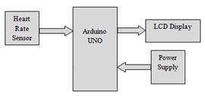
Device & Components
Figure-2: Block diagram of measuring the heart rate.

Slide 9
Methodology
Firstly, we have collected a large amount of heart rate and systolic blood pressure data.
Then we have find the pattern between heart rate and systolic blood pressure.
Based on these pattern, we have proposed regression equation for three category.
Figure-3 shows the block diagram of flow of regression model.

Slide 10
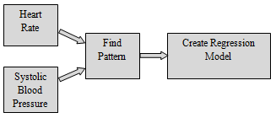
Methodology
Figure-3: Regression Model flow in our model

Slide 11
Methodology
Figure-4 shows our proposed regression equation for three category.
X= Input = HR for each individuals
Y= Output = SBP for each individual HR

Slide 12
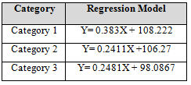
Methodology
Figure-4: Proposed Regression Model

Slide 13
Methodology
Now the final circuit diagram of our proposed method is shows in figure-5.
We have applied our proposed regression equation in this diagram to calculate systolic blood pressure from heart rate.

Slide 14
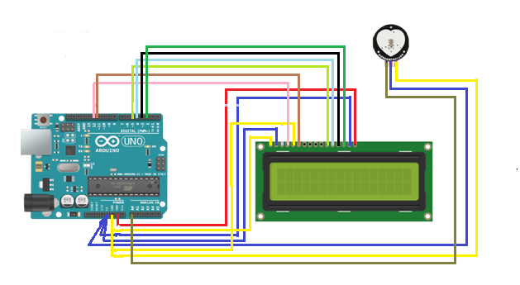
Methodology
Figure-5: Final Circuit Diagram

Slide 15
Discussion
We have compared our method to another state-of-the-art method [3], to find the accuracy of our proposed method.
We also use the data which was used in [3] and compared the accuracy.
Our method perform 50% better than [3].
Figure-6(a) shows the considered value and Figure-6(b) shows the accuracy.
[3]Hassan, M.K.B.A., Mashor, M.Y., Nasir, N.M. and Mohamed, S., 2008. Measuring of systolic blood pressure based on heart rate. In 4th Kuala Lumpur International Conference on Biomedical Engineering

Slide 16
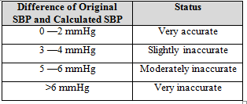
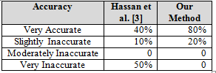
Discussion
Figure-6(a): Considered Value
Figure-6(b): Accuracy Comparison

